Slide 1
AB Testing
FoDS Practice, by Aravind S
CB.EN.U4CSE20208

Slide 2
Dataset : Reliance Stock Price
The closing, opening, high and low price of reliance on a daily timeframe, it also include the number of trades taken in that particular day
Labelled on our own, high and low (Trades>150000, Trades<=150000)
Hypothesis
Null Hypothesis (H0) : The mean of High and Low are the same, High is greater than Low by chance
Alternate Hypothesis (Ha) : The mean of High is greater than Low

Slide 3
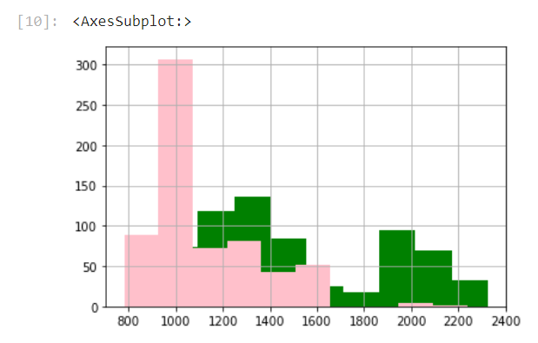
Histogram
Green : High
Pink : Low

Slide 4
Analysis
The test statistic is the difference in the average total.
The observed test statistic is 387
When a random sample is simulated using permutation the differences observed are plotted along with the observed difference for each.

Slide 5
Conclusion
Since from the plot it is obvious that the observed statistic is not in the histogram
Therefore, we can reject the null hypothesis
Thus, proving that they are not by chance, and we can prove that the mean of High is greater than Low

